Slide 1
Component
By Shalini Gupta

Slide 2
Takeaway
What is component?
How to render a component?
How to create a new component?

Slide 3
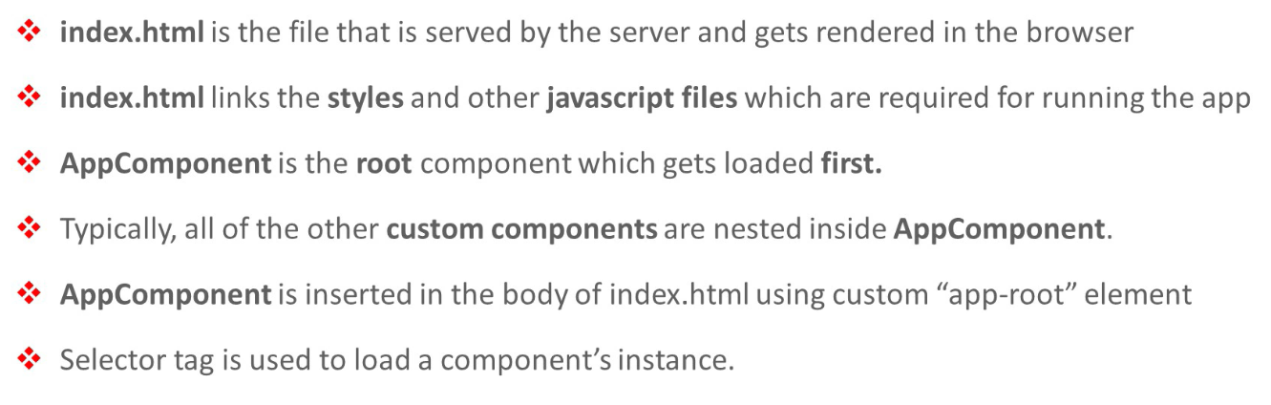
Key Points

Slide 4
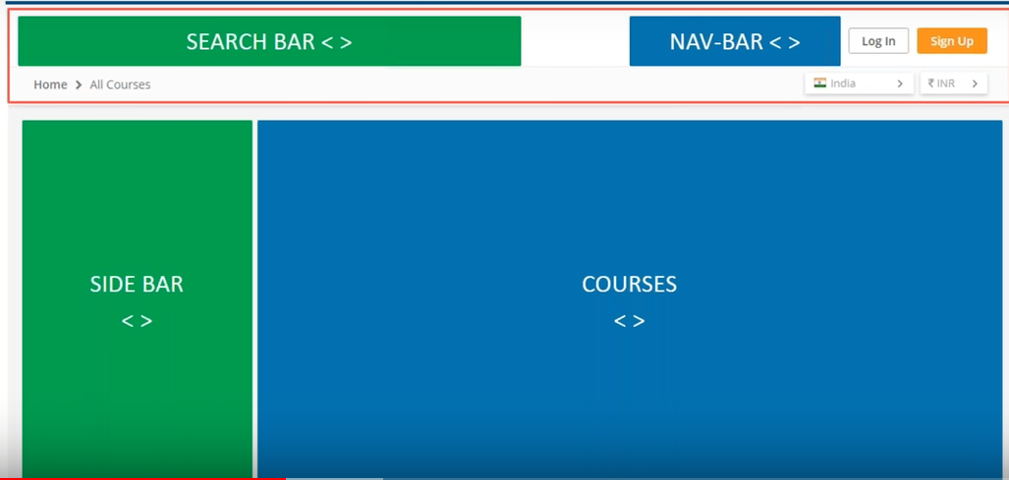
Component Example

Slide 5
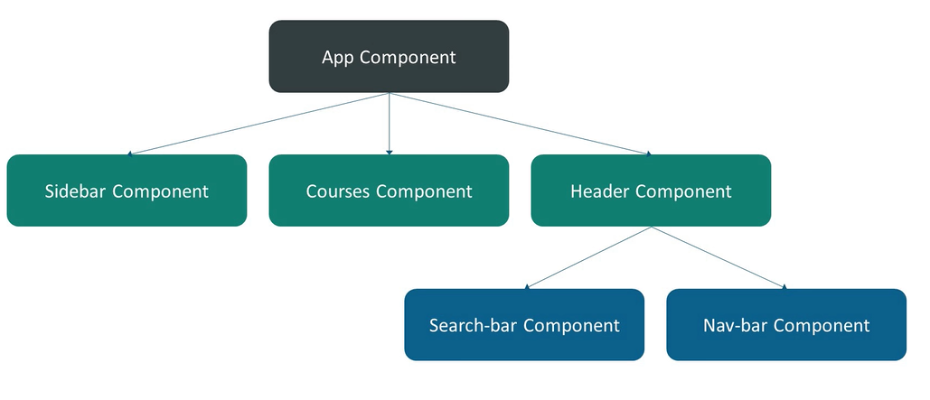
Parent/Child

Slide 6
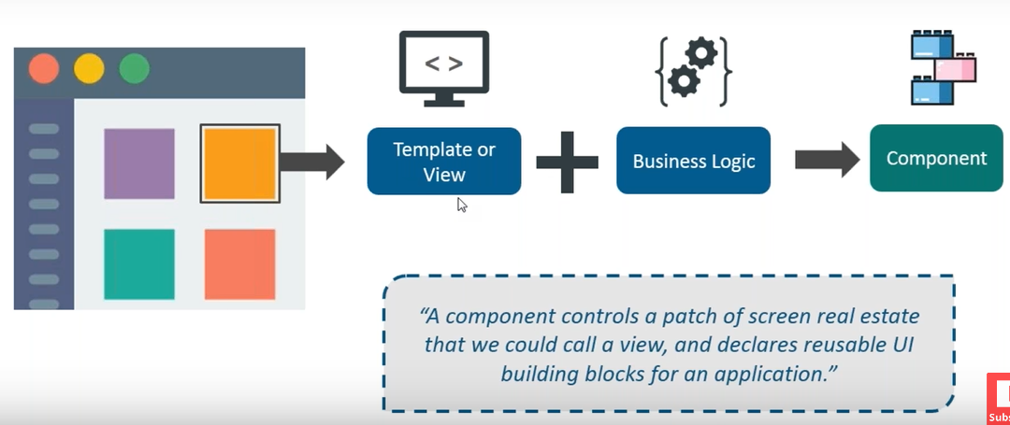
Component

Slide 7
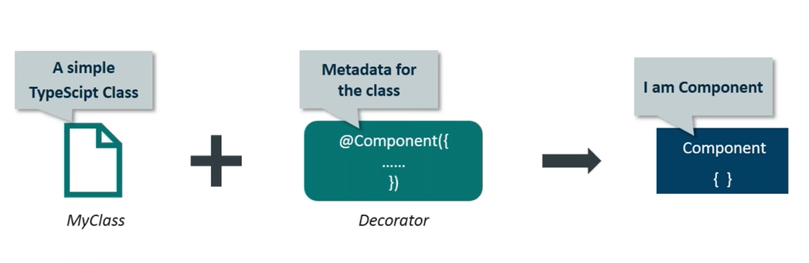
Creating Component

Slide 8
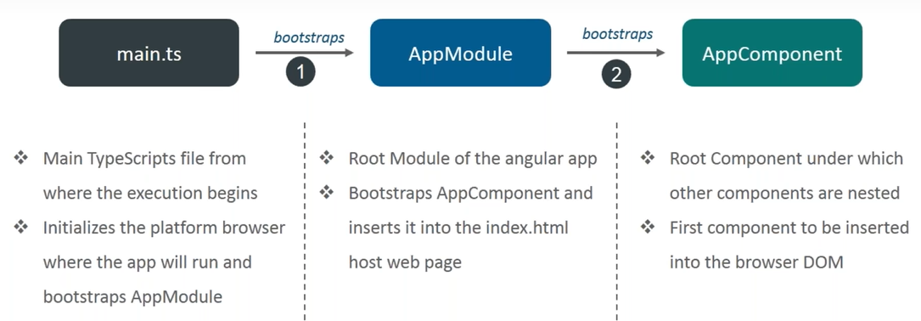
Angular App Bootstrap

Slide 9
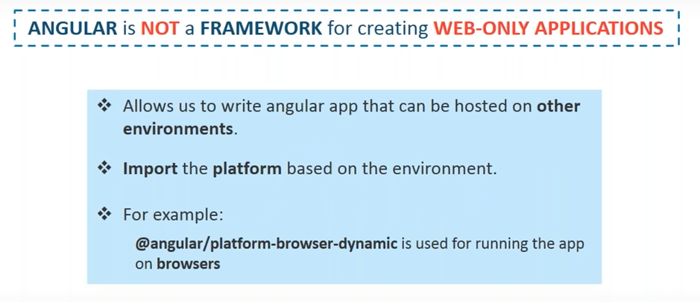
Why Bootstrapping?

Slide 10
Reference Links

Slide 11
Thank you!!

